Slide 1
Latinx Critical Race Theory
Joanna Jaimes

Slide 2
Latinx critical race theory
What is LatCrit and where did it come from?
How is it useful?
Critiques
How can we use it in practice?

Slide 3
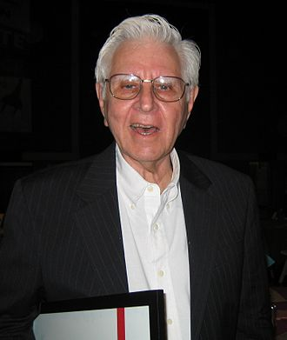
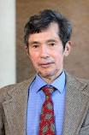
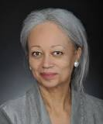
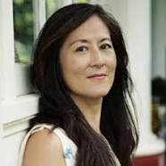
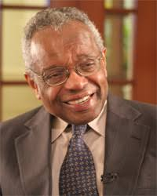
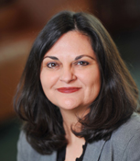
What is Latinx Critical Race Theory?
Ricard Delgado
Rodolfo Acuña
Critical Race Theory
1970s
Activists, lawyers, scholars realized that the advances of the civil rights era came to a pause and were being rolled back
Borrowed terms and ideas from social movements (feminist, civil rights)
Patricia Williams
Mari Matsuda
Derrick Bell
Laura Gomez

Slide 4
Basic Tenents of Critical Race Theory
Intersectionality of racism
Challenges to dominant ideology
Commitment to social justice
Importance of experiential knowledge
Use of an interdisciplinary approach
LatCrit explores the ways that so-called race-neutral laws and policies perpetuate racial and/or ethnic and gender subordination. It also challenges Eurocentric ideologies that advance whiteness. This theoretical framework is most often used in educational research.

Slide 5
Power
Assumptions of white supremacy
White privilege & Meritocracy
Fuels cultural repression
Assimilation
Anything outside the Eurocentric norm, especially in the context of education, is often devalued and delegitimized.
Life experience
Story telling as a form of knowledge
“Evidence-based”
Eurocentric theories, perspectives

Slide 6
LatCrit in Action
Areas where LatCrit has provided a holistic and socially just lens
Language rights
Seeing the value in bilingual education and services
Education
Acknowledging and validating lived experience as a source of knowledge
Storytelling and naming one’s own reality as a way to invoke change

Slide 7
Where did LatCrit come from?
Critical Race theory (CRT)
lATcRIT contributions
Considers many of the same issues as civil rights and ethnic studies but places them in the context of economics, history, and culture
Questions the foundation of legal reasoning, Enlightenment rationalism, and neutral principles of constitutional law
A subgroup of CRT that specializes in issues that affect Latinx folks
Education, language rights, immigration policy
Intersection of machismo, gender norms, citizenship & nativism

Slide 8
CRITIQUE
Cannot be tested
Subjective, reliance on moral relativism
Relies on narratives

Slide 9
Connection to Practice
Aligns with the values of strengths-based perspective
Macro practice
Collaborating with communities: Community members lead the way, acknowledging that they are the experts in the issues that most affect them
In research: Decolonizing our idea of what is valid and worth studying
IP work
Clinicians can use the theory to begin to understand where a client is at
Can use theory with others such as person in environment
Cultural wealth (Yosso, 2005)
Aspirational, linguistic, familial, social, navigational, resistance

Slide 10
References
Bernal, D. D., (2002). Critical Race Theory, Latino Critical Theory, and Critical Raced-Gendered Epistemologies: Recognizing Students of Color as Holders and Creators of Knowledge. Qualitative Inquiry, 8(1), 105–126. Feature, Thousand Oaks, CA: Sage Publications.
Delgado, D., Stefanic. J. (2012) Critical Race Theory. New York: NYU Press.
Huber, L. P. (2010). Using Latina/o Critical Race Theory and racist nativism to explore intersectionality in the educational experiences of undocumented Chicana college students. Educational Foundations, 24(1–2), 77. Ann Arbor: Caddo Gap Press.
Yosso, T. J. (2005). Whose culture has capital? A critical race theory discussion of community cultural wealth. Race Ethnicity and Education, 8(1), 69–91. Original Articles, United Kingdom: Taylor and Francis Ltd.

Slide 11
Questions
1. How can we conceptualize LatCrit in social work?
2. How do you envision LatCrit could be helpful when creating policy?
3. What types of cultural wealth do you see in the communities that your working with? Can you frame their strengths using LatCrit?
Cultural wealth (Yosso, 2005)
Aspirational, linguistic, familial, social, navigational, resistance

